Slide 1
App for Ayush Services Availability
Team members : Guide :
C. Rashmika 2451-19-737-003 dr. H. Jayasree
S. Sushma 2451-19-737-303
Sk. abdul wasay 2451-19-737-304

Slide 2
contents
Abstract
Introduction
Problem Statement
Literature Survey
Existing System
Proposed System
System Requirements
System Architecture
UML Diagrams
Module Splitup
Methodology
Result
Conclusion
References

Slide 3
abstract
Traditional medicine is recognized globally for complementing disease prevention, treatment, and generic health maintenance. There is the widespread use of traditional medicine across developing countries. However, despite increasing national and international attention, the use of these health systems is low due to a lack of information.
This project provides information about AYUSH Ministry services so that people will get to know about the locations of nearby AYUSH hospitals with opening and closing times. It displays information relevant to the hospital demographics, inpatient procedure rates, and outpatient departments by integrating various bio-medical data sources.

Slide 4
introduction
AYUSH stands for Ayurveda, Yoga and Naturopathy, Unani, Siddha and Homeopathy which are the six Indian systems of medicine prevalent and practiced in India and some of the neighboring Asian countries.
The goal of AYUSH is to reduce diseases and improve people’s mental, physical, and spiritual health.
Ayurveda, yoga and homoeopathy are not new to our country and are an integral part of Indian culture. However, it is frequently given less weight than modern medicine. The Ministry of AYUSH was created to promote and find alternative medicine methods except for modern medicines.
There are approximately 4000 Ayush hospitals across India distributed under different council and hospitals of the government of India.

Slide 5
Problem statement
To build AYUSH hospitals mobile application using google Map API which shows the locations of nearby AYUSH hospitals with opening time and closing time.

Slide 6
Literature survey
SNO | Name | Description | Released Year | Developed & Funded | Limitations
1. | AYUSH Sanjivani App | The app intends to generate data on usage of AYUSH advocacies and measures among the population and its impact on prevention of Covid-19. | 2020 | Ministry of AYUSH | It is limited to providing surveys and generating reports on public health who are effected by Covid-19.
2. | Yoga Locator Application | This app helps to find Yoga trainers, Yoga Centers, and Yoga Events around your area. It will also enable yoga instructors to register themselves and reach out to a large number of people. | 2019 | Ministry of AYUSH | It is only limited to Yoga Services.

Slide 7
SNO | NAME | Description | Released Year | Developed & Funded | Limitations
3. | A-HMIS (portal) | It is a comprehensive IT platform to effectively manage all functions of health care delivery systems and patient care in AYUSH Facilities. | 2018 | CCRS - Central Council for Research in Siddha, Ministry of AYUSH | It does not show the nearby location of AYUSH Hospitals.
4. | Siddha –NIS app | It consists of information about Siddha, its therapies, types of medications, and details about NIS(National Institute of Siddha). | 2018 | Centre for Development of Advanced Computing (C-DAC), Ministry of AYUSH | It only provides information of Siddha Services.

Slide 8
Existing system
There are some applications that provide basic information about the different AYUSH services.
During covid-19 some apps enhanced immunity of people by taking regular surveys and generating reports on their health.
Few portals display some locations of the AYUSH hospitals .

Slide 9
proposed system
This project shows the locations of nearby AYUSH hospitals with opening times and closing times and contact information such as email id and phone number along with that it provides the rates of the procedures or treatments.

Slide 10
System Requirements
HARDWARE :
Processor: Core i3
Hard disk: 250 GB
RAM: 8GB
SOFTWARE :
OPERATING SYSTEM: WINDOWS 10
PROGRAMMING LANGUAGE: Java
IDE : Android Studio.

Slide 11
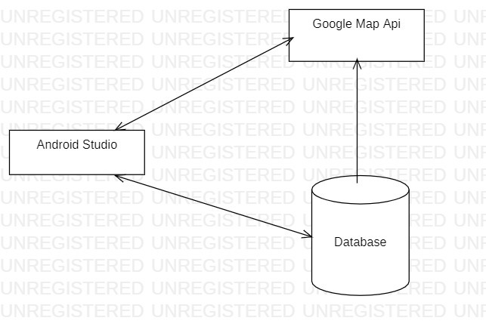
SYSTEM ARCHITECTURE

Slide 12
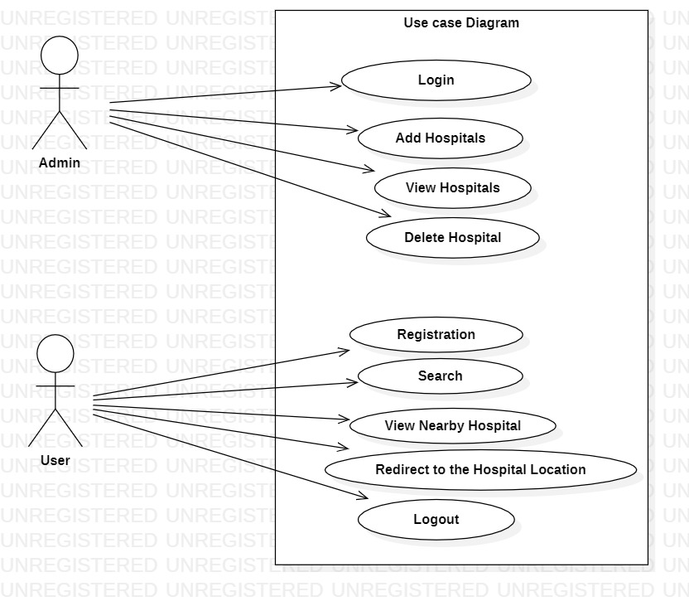
USE CASE DIAGRAM

Slide 13
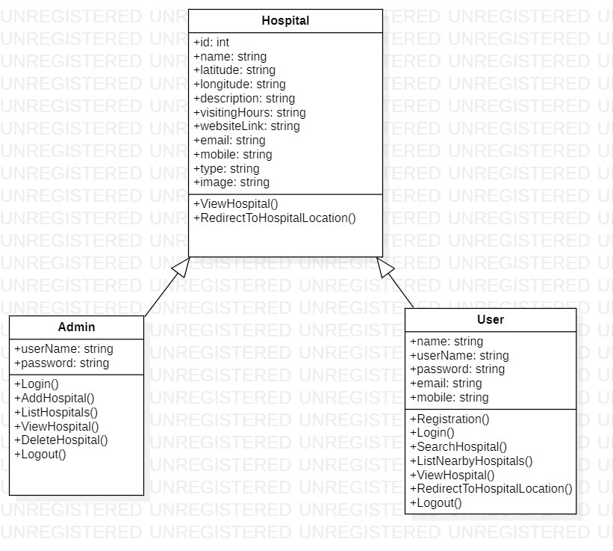
Class Diagram

Slide 14
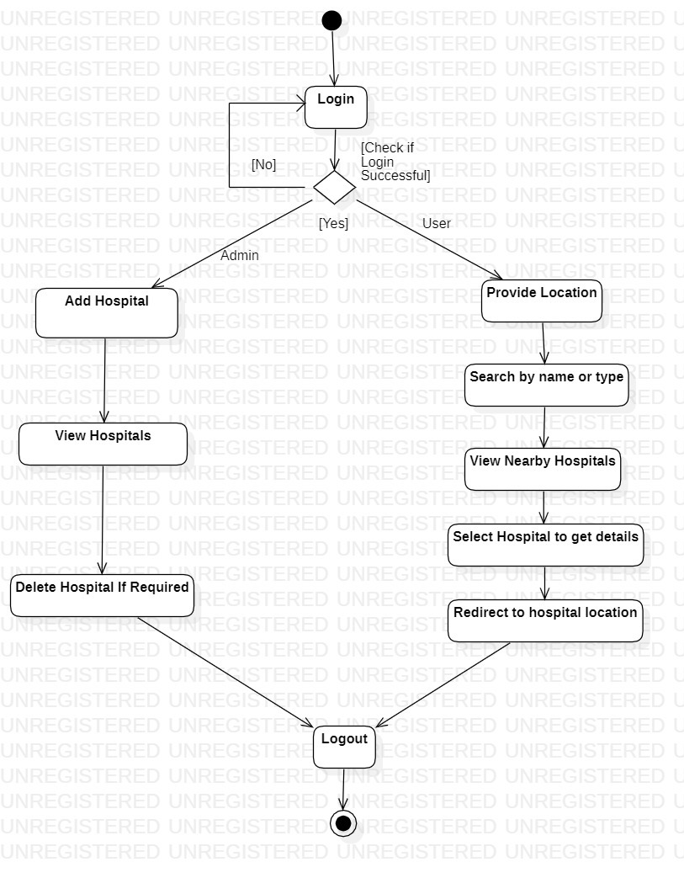
Activity Diagram

Slide 15
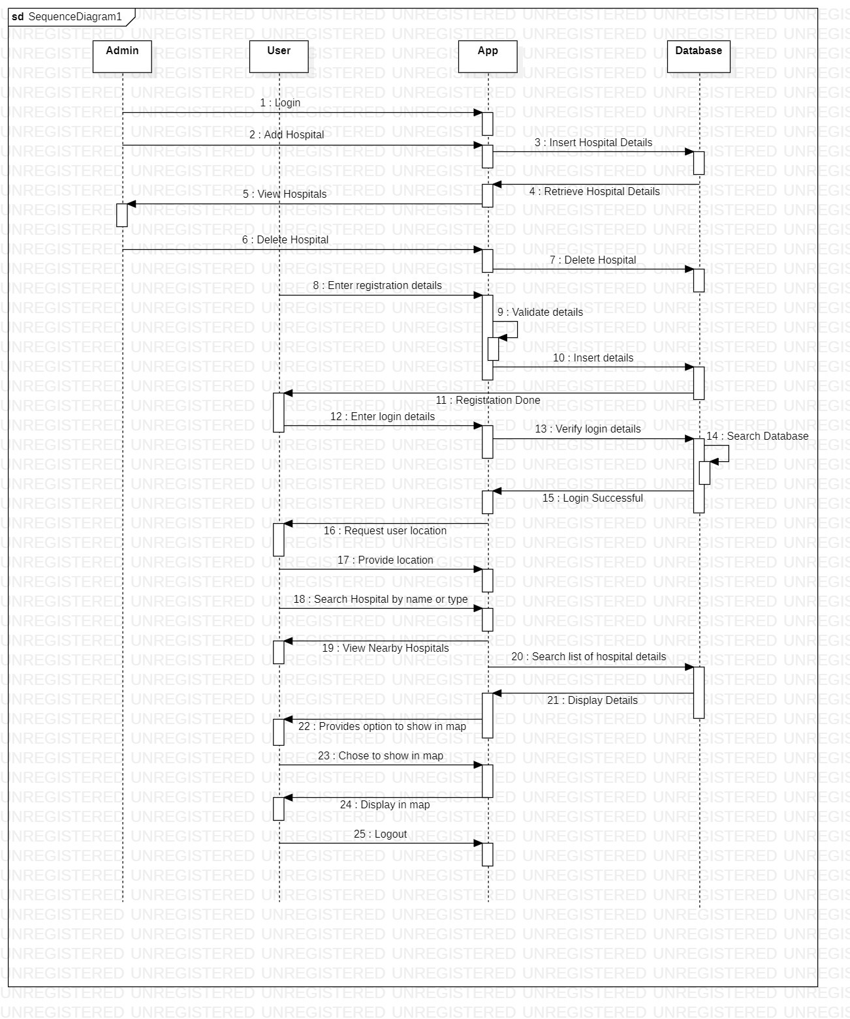
Sequential Diagram

Slide 16
Modules
Register
Log In
Add Hospital
View Hospital
Search Hospital
Nearby Hospital
Log Out

Slide 17
Module split-up
REGISTER:
User should register themselves by providing their details. They need to provide name, username, password, email(optional), mobile. Then an otp is sent to the user's phone using which they can complete their registration.
LOG IN:
The user is required to log in to the application to view nearby hospitals or search hospitals based on their preference. Both admin and user have a common login page based on their role. To log in, both admin and user needs to enter their username and password. If the provided credentials are correct, the user will be logged in, and further operations can be performed. If not the page informs that the credentials are invalid.
ADD HOSPITAL:
Admin can add a hospital by providing hospital's details. These details include hospital name, location (here the latitude and longitude coordinates should be given), description, visiting hours, website link, hospital email, hospital mobile, type of service and image(optional). If all the fields are provided it will be successfully registered. If not, it informs admin to enter valid data.
VIEW HOSPITALS:
Admin can view all the list of hospitals present in the database. By clicking on a hospital they can see all the details of the particular hospital including an option to view hospital on google maps and another option to delete that particular hospital.

Slide 18
Module Split-up
VIEW HOSPITALS:
Admin can view all the list of hospitals present in the database. By clicking on a hospital they can see all the details of the particular hospital including an option to view hospital on google maps and another option to delete that particular hospital.
SEARCH HOSPITAL:
User can search for a hospital hospitals based on their name, location or type of service. It also provides an option to search by voice input. By clicking on search after providing the input it shows all the related hospitals.
NEARBY HOSPITAL:
User can view all the hospitals which are nearer to the user and access the hospital which they want.
LOG OUT:
Log out is a common module for users and admin. This module is used to log out from the application and end the current session.

Slide 19
Methodology
Admin Panel: The Admin can Add Hospital Information and Hospital list that provides the which type of service in the hospital and admin can add timings of the Hospital and more. Admin can view the Hospital information and edit the information, providing the contact of the hospital too. Admin can delete the hospitals information. The hospital information will be stored and retrieved from the database.
Identify the data that you need to display for each hospital and the features that you want to include, such as the ability to search for hospitals by name or location, view details about each hospital, and get directions to the hospital.
Set up the development environment: Download and install Android Studio, and set up the development environment. Create a new project and set up the basic user interface for application. We will also need to create a Google Cloud Platform account to get an API key for Google Maps API.
Add the necessary dependencies: To use Google Maps API, we will need to add the following dependencies in the app-level build.gradle file:
implementation 'com.google.android.gms:play-services-maps:17.0.0’
implementation 'com.google.android.gms:play-services-location:17.0.0'

Slide 20
Get the API key: Go to the Google Cloud Platform Console, create a new project, enable the Maps SDK for Android and Places API, and generate an API key.
Set up Google Maps API: In the AndroidManifest.xml file, add the following permissions and meta-data:
<uses-permission android:name="android.permission.ACCESS_FINE_LOCATION" />
<uses-permission android:name="android.permission.ACCESS_COARSE_LOCATION" />
<meta-data
android:name="com.google.android.geo.API_KEY"
android:value="API_KEY" />
Design the user interface: We use the layout editor in Android Studio to design the user interface for the app. We will include a map fragment to display the map and other UI components like buttons and text fields.

Slide 21
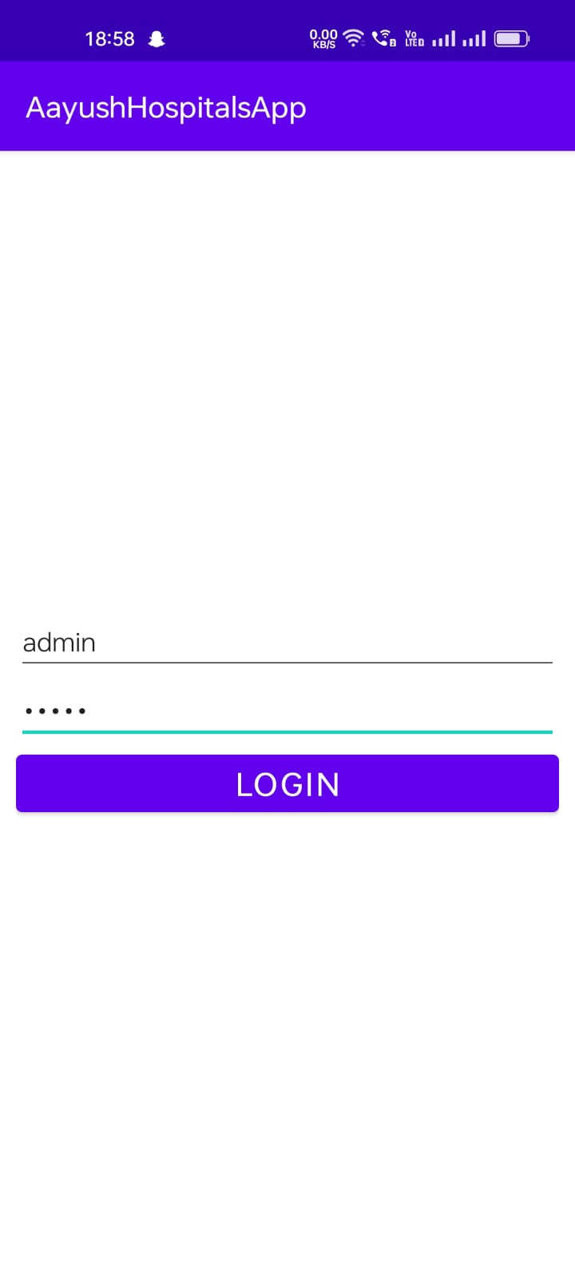
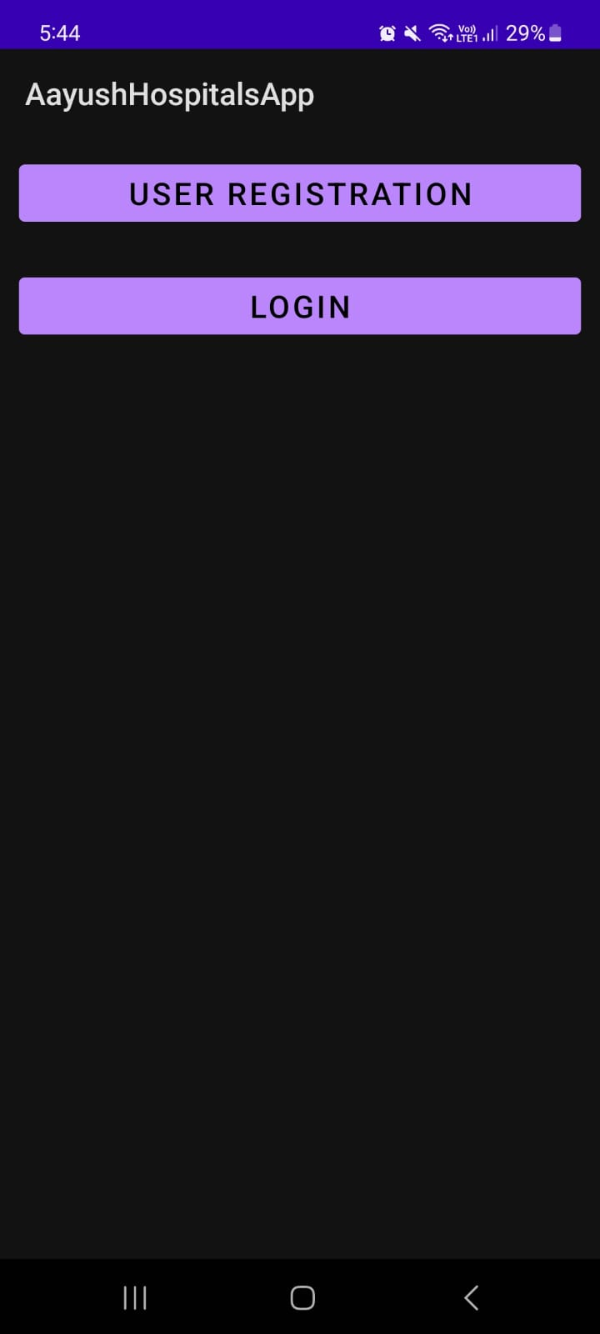
results: (screenshots)
It shows the App interface when Ayush Application is opened.
It shows the login page of the admin.

Slide 22
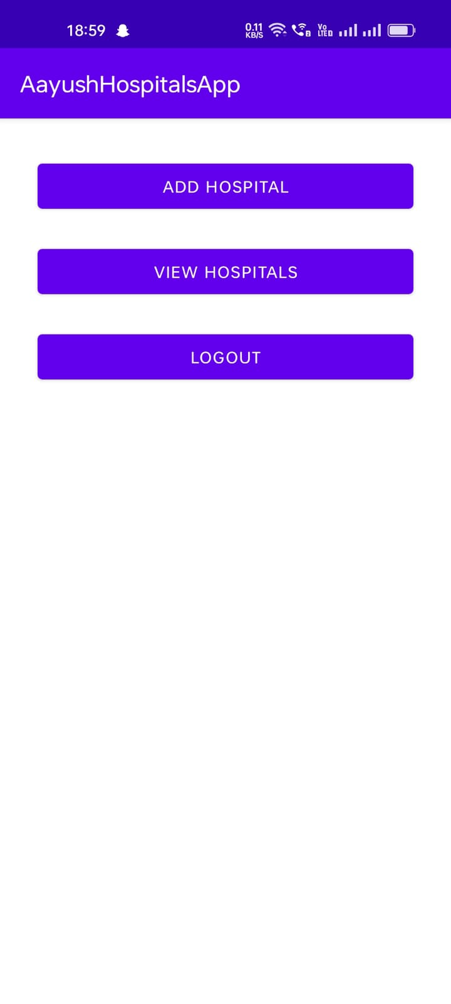
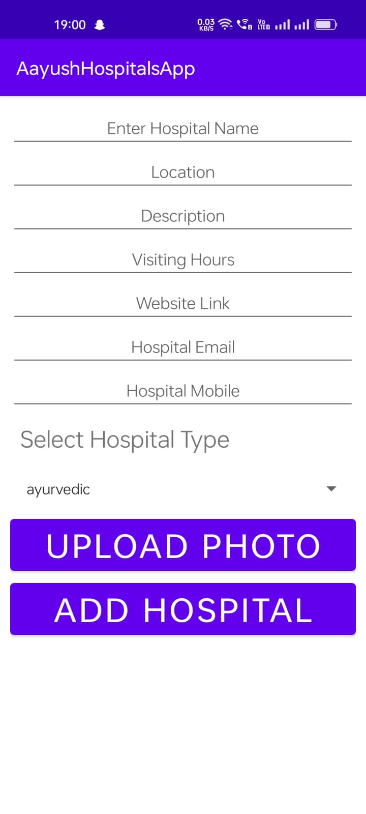
It shows after the login of the admin
Admin can view hospital and add the information of the hospital, admin can delete the hospital if the hospital is removed by Government in Ayush list.

Slide 23
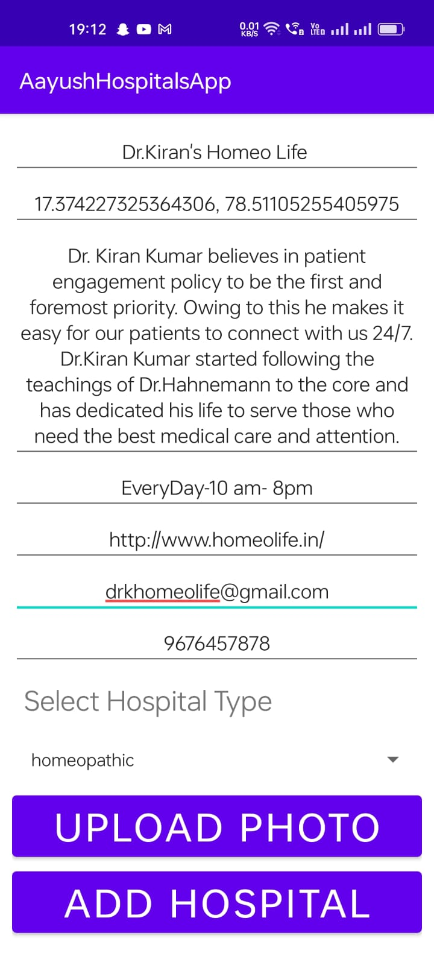
Admin adding a hospital information. By this user can access the information and redirect to go the location of the Hospital. Hospital has some description and its opening and closing timing of the hospital and if the user needs more information user can redirect to the hospital website too. For more convenience of the user we added Mail and Mobile number of the Hospital.

Slide 24
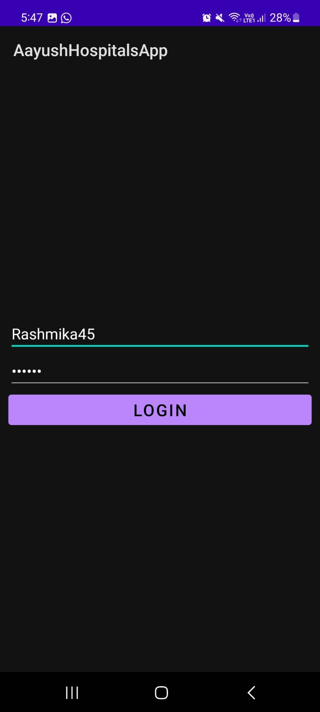
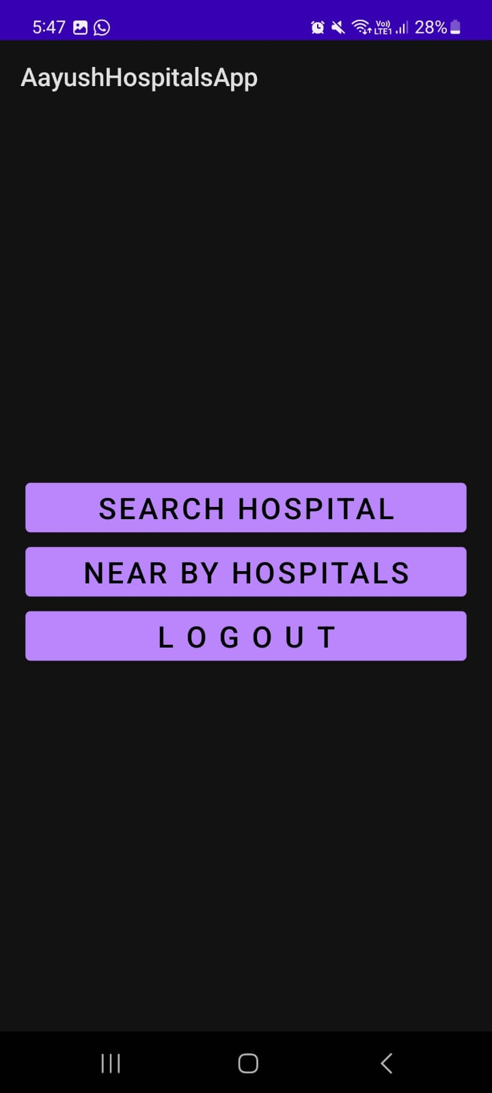
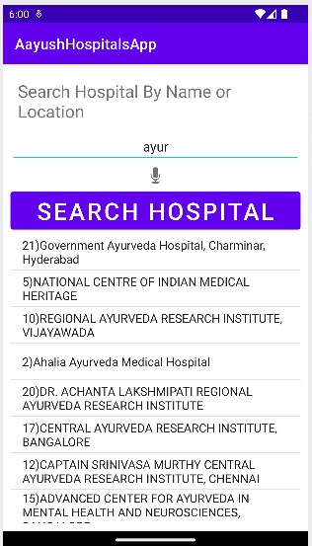
Fig 1:It shows the login page of the user.
Fig 2:It Shows the interface of app and user after login by the User.
Fig 3:The user can search by type of the hospital or user can search by hospital name too.

Slide 25
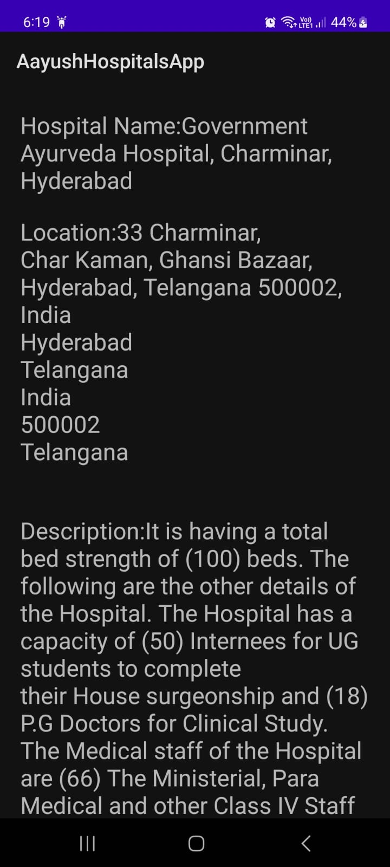
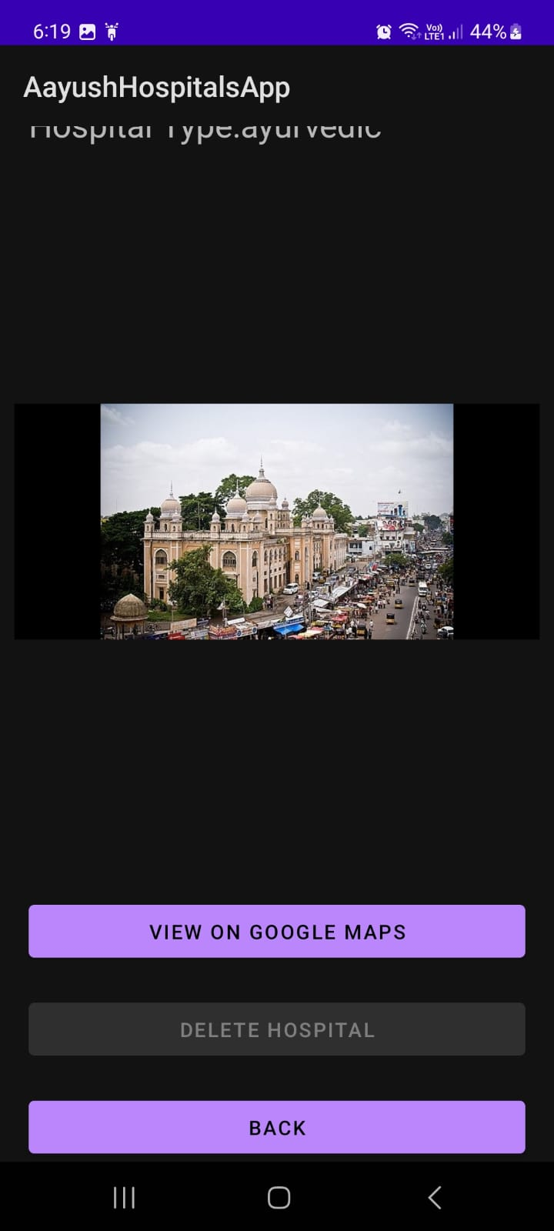
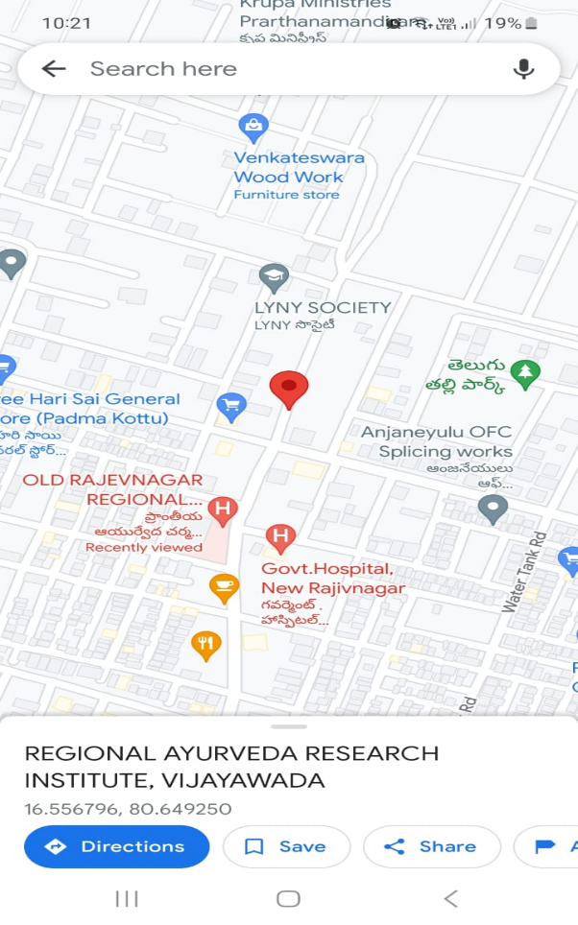

Slide 26
Conclusion
This project provides information about AYUSH Ministry services and displays the locations of nearby AYUSH hospitals with opening and closing times on the map. This project serves as a one-stop application that helps people to find all the required information along with routes to AYUSH hospitals.

Slide 27
REFERENCES
Janmejaya Samal, Public Health Researcher, “Role of AYUSH workforce, therapeutics, and principles in health care delivery with special reference to National Rural Health Mission”.
Sendhilkumar Muthappan, Rajalakshmi Elumalai, Natarajan Shanmugasundaram, Nikiniva Johnraja, Hema Prasath, Priyadharishini Ambigadoss, Ambika kandhasamy,dhivya kathiravan, “AYUSH digital initiatives: Harnessing the power of digital technology for India’s traditional medicinal systems.
https://main.ayush.gov.in/ - Ministry of AYUSH

Slide 28
Thank you

